Slide 1
Financial Sustainability for Youth Run Programs Session One

Slide 2
DISCLAIMER
This presentation was prepared for NTTAC under a cooperative agreement from the Substance Abuse and Mental Health Services Administration (SAMHSA). All material appearing in this presentation, except that taken directly from copyrighted sources, is in the public domain and may be reproduced or copied without permission from SAMHSA or the authors. Citation of the source is appreciated. Do not reproduce or distribute this presentation for a fee without specific, written authorization from NTTAC. This presentation will be recorded and posted on our website.
This event is supported by SAMHSA of the U.S. Department of Health and Human Services (HHS) as part of financial assistance award SM-20-008 over five years (2020-2025) with 100 percent funded by SAMHSA/HHS. At the time of this presentation, Miriam Delphin-Rittmon served as Assistant Secretary for Mental Health and Substance Use and Administrator of SAMHSA. The contents are those of the author(s) and do not necessarily represent the official views of, nor an endorsement, by SAMHSA/HHS, or the U.S. Government.

Slide 3
NTTAC Overview

Slide 4
OUR MULTIDISCIPLINARY TEAM

Slide 5
OUR GOAL
All children, youth, young adults, and families with emotional or behavioral health needs can access evidence-based treatment and recovery services in a well-coordinated system of care.

Slide 6
WHO WE SERVE
Examples of our key cross-sector audiences:
State and local agency leaders
Mental health workforce - Social workers, clinicians, home visitors, etc.
Primary care providers
School workforce
Community-based providers
Peer supervisors
Family partners
Youth partners
www.nttacmentalhealth.org
6

Slide 7
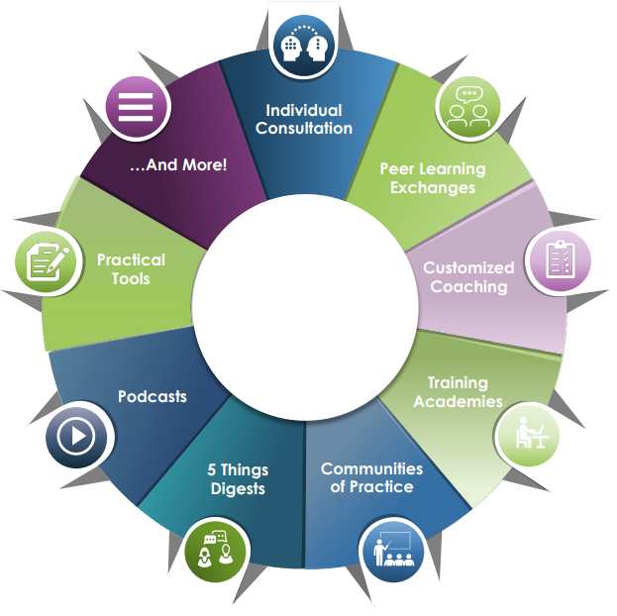
OUR SERVICES
No-cost training, technical assistance, and resources
www.nttacmentalhealth.org
7

Slide 8
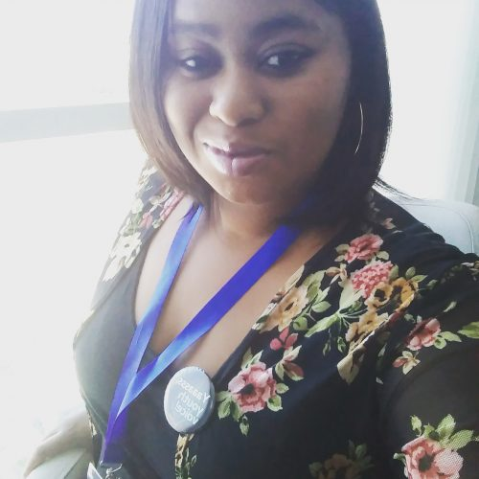
TODAY’S PRESENTERS
Johanna Bergan
Executive Director
Youth MOVE National
Johanna@youthmovenational.org
Jasmine Boatwright
Youth Program Coordinator
Youth MOVE National
Jasmine@youthmovenational.org
www.nttacmentalhealth.org
8
Notes:
Johanna and pass to Jasmine

Slide 9
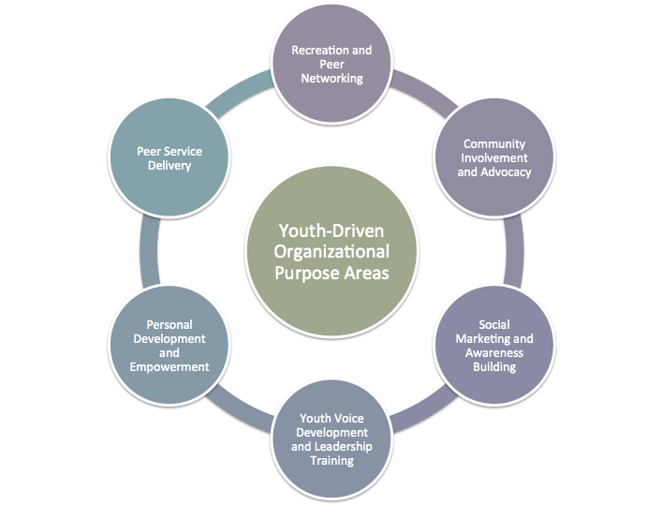
Learning for Youth Run Organizations
These learning sessions are designed for youth run programs and organizations.
Youth run organizations are controlled and managed by youth with lived experience in youth serving systems and are dedicated to improving these systems to be youth-driven.
Youth run organizations operate in many ways and offer diverse programming including:
Youth Driven Program Purpose Areas
www.nttacmentalhealth.org
9
Notes:
Jasmine

Slide 10
SESSION OBJECTIVES
Develop working knowledge of what sustainability is for youth run programs
Identify foundational documents needed to support sustaining youth run programs
Understand the importance of evaluation to sustainability efforts
Learn about the importance of building and documenting partnerships to support sustainability
www.nttacmentalhealth.org
10
Notes:
Jasmine

Slide 11
What is Sustainability?
Youth Driven Leadership
+
Adaptability
+
Program Capacity
=
Sustainability
Find out more about this definition in the Rocking Your Youth MOVEment: A Guide to Rockstar Guide
www.nttacmentalhealth.org
11
Notes:
Jasmine

Slide 12
The Importance of Logic Models
Provide direction in creating and defining your programs goals, activities, and outcomes
When would a logic model help?
When you are just starting out! And developing your first goals and plans
At times you feel overwhelmed about how much is going on and being done but underwhelmed by your success
When you are running a really successful program and want to document to duplicate!
Development of a logic model is a group effort and must include youth voice
More resources on how to approach logic modeling can be found here:
Why and How to do Logic Models
Logic Models for Youth Leaders (Webinar)
Youth MOVE Youth Peer Logic Model (Example)
Blank Logic Model Template
www.nttacmentalhealth.org
12
Notes:
Jasmine starts and then hands to Johanna

Slide 13
Theory of Change Logic Model
Mission Statement
Vision Statement/Impact Statement
Inputs/Resources:
Goals:
Strategies/Activities:
Outcomes:
Continuous Quality Improvement & Evaluation
Notes:
Johanna

Slide 14
The Importance of Strategic Planning
Strategic planning is a tool for organizational development and a process to give direction to your work
Plans often include short, medium, and long term goals for the next 1 to 5 years
Goals should be SMARTIE (example: goals worksheet here)
Specific
Measurable
Achievable
Relevant
Time-Bound
Inclusive
Equitable
Strategic Planning for Youth Organisations
#Things2Consider Strategic Planning
Notes:
Johanna

Slide 15
Why Evaluate?
Determine if you’ve met your goals
Utilize data-informed decision making
Support quality improvement efforts
Share your successes
Support sustainability efforts
Support advocacy efforts
Notes:
Johanna

Slide 16
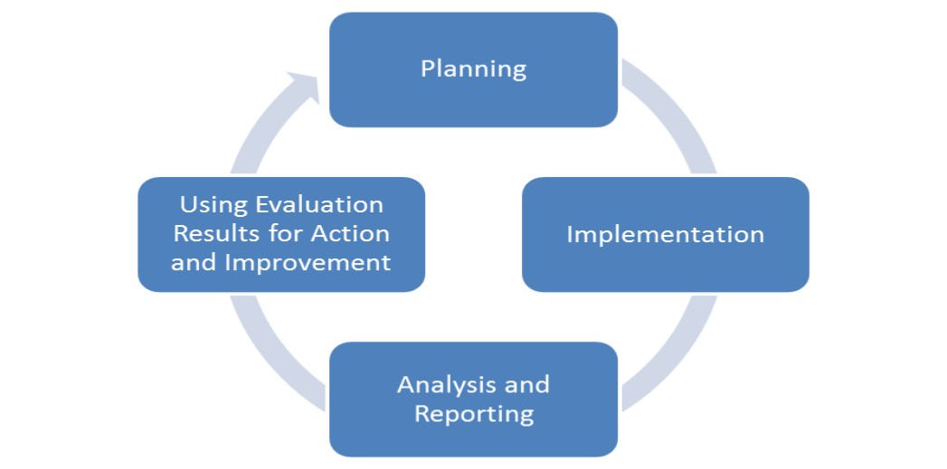
Evaluation Cycle
What should we track for information?
What do we need to know about our activities?
What method would work best to capture data?
What resources might we need?
Creating an Evaluation Plan
Figure 1. Evaluation Cycle CNCS, 2016
Notes:
Johanna
In a nutshell, this graphic provides an overview of the evaluation cycle. You start with your initial plan- whether it be a training, a new service, a program, or an organization, you must develop goals and objectives specific to this activity that you are hoping to achieve. Once you’ve accomplished this, you move into the implementation phase. From there, you begin the process of evaluating- observing, conducting research and collecting data that feeds back into your plan. The findings of your evaluation cycle back into your plan and informs how you are doing and wether you are performing well or doing poorly. No evaluation is good unless the results are used to make a difference.

Slide 17
Key Steps for Partnership Development
Identify Core Needs
Partnerships are designed to address a very specific set of core needs and ongoing operations related to funding, activities, infrastructure, and evaluation. Having a clear focus on your primary needs helps guide how your leadership team will invest time and resources.
→
Identify Partners
Partnerships in which there is a clear mutual benefit are full of inspiration, excitement, clear and consistent levels of understanding purpose, open communication, and embracing of differences in philosophies and work styles.
→
Build Partnerships
Start with the end in mind—what does the Youth Driven Leadership Team hope to achieve? Aim to connect purpose and youth activities to the mission, vision, and goals of your potential partner.
→
Maintain Partnerships
It is important to put in good systems for tracking and cultivating these partnerships to ensure financial and time commitment do not outweigh the potential benefits.
Notes:
Jasmine

Slide 18
Document Your Partnerships
Create a Linkage Agreement
Linkage Agreement Template
Linkage Agreement Activities List
Overview/Instructions for the Linkage Agreement
Other Partnership Documents
Memorandum of Understanding - an agreement between two or more parties outlined in a formal document. It is not legally binding but signals the willingness of the parties to move forward with a contract.
Memorandum of Agreement - a useful placeholder that helps you outline terms for nearly any kind of new business relationship. You can use it to set up the foundation for a partnership by laying out specific objectives, milestones, or final outcomes.
Memorandum of Understanding Template
Notes:
Jasmine

Slide 19
Recommended Next Steps
Watch part two of this learning series!
Watch the Sustainability video series (and share the series with youth leaders in your program): https://youthmovenational.org/sustainability
Develop or refresh your organization/program logic model
Develop or refresh your organization/program strategic plan
Request training or consultation support from NTTAC here

Slide 20
Resources
Youth Driven Program Purpose Areas
Rocking Your Youth MOVEment: A Guide to Rockstar Sustainability
Strategic Planning for Youth Organisations
#Things2Consider Strategic Planning
Why and How to do Logic Models
Logic Models for Youth Leaders (Webinar)
Youth MOVE Youth Peer Logic Model (Example)
Blank Logic Model Template
Things2Consider: Measuring Success
Things2Consider: Measuring Success (Espanol)
Assessing Youth Voice: The Youth Voice at the Agency Level Assessment (Y-VAL) and Youth Voice on Councils and Committees Assessment (Y-VOC)
Memorandum of Understanding Template
Youth MOVE Sustainability Video Series
The Role of Youth-Run Organizations in Improving Services and Systems
Notes:
Jasmine

Slide 21
CONTACT INFO
Email: NTTACinfo@cars-rp.org
Phone: 888.945.9377
Website: http://www.nttacmentalhealth.org
Download our flyer: https://bit.ly/nttac-flyer
Request TA: https://tinyurl.com/RequestNTTAC-TTA
GET SOCIAL WITH US!
Facebook: @nttac.mh
Instagram: @nttac.mh
Twitter: @nttac_mh
Notes:
Jasmine
We also want to thank NTTAC for hosting these exchanges. Here is their contact information if you have a need to contact them.

Slide 22
Thank you.
SAMHSA’s mission is to reduce the impact of substance abuse and mental illness on America’s communities.
www.samhsa.gov
1-877-SAMHSA-7 (1-877-726-4727) ● 1-800-487-4889 (TDD)

